Slide 1
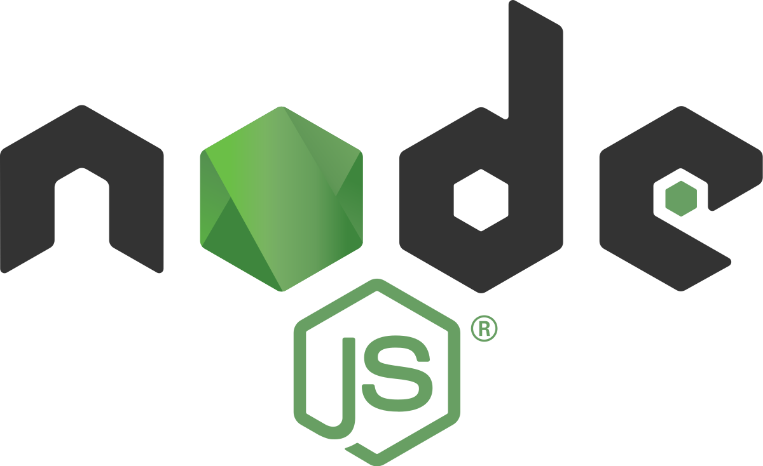

Slide 2
Node js
By Komal Singh

Slide 3
The idea behind node.js….
Perform asynchronous processing on single thread instead of classical multithread processing, minimise overhead & latency, maximise scalability
Scale horizontally instead of vertically
Ideal for applications that serve a lot of requests but dont use/need lots of computational power per request
Not so ideal for heavy calculations, e.g. massive parallel computing
Also: Less problems with concurrency

Slide 4
What is Node js?
Node is not a language
Node is a server environment
Node js can connect with the database
Code and syntax is very similar to javascript but not exactly the same.
Node js free ,open source
Node js use chrome’s v8 engine to execute code.
Node JS provides fast and highly scalable services.
The source code in node js is more consistent and clean.
It provides a large ecosystem for open source libraries.

Slide 5
Definition of node js
Node JS is an open-source and provides a cross-platform runtime environment that helps for executing javascript code outside the browser.
Hence it is not the framework and its not a programming language. Most of the time node js are used as building back end services like APIs (Web App or Mobile App).
Large companies like Netflix, Wallmart, PayPal, Uber use the node js.

Slide 6
Why do we use Node
NodeJs is built on Google Chrome’s V8 engine, and for this reason its execution time is very fast and it runs very quickly.
Node js is mostly used for API.
So we can connect the same databse with web app,mobile app.
Node js is easy to understand who know javascript.
Node js is superfast for APIs.
With node and javascript ,you became the full stack developer.
NodeJS Applications:
Complex single-page applications.

Slide 7
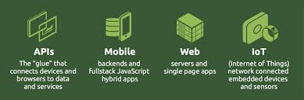
Real-Time Chats.
Real-time collaboration tools.
JSON APIs based application.
Streaming apps.

Slide 8
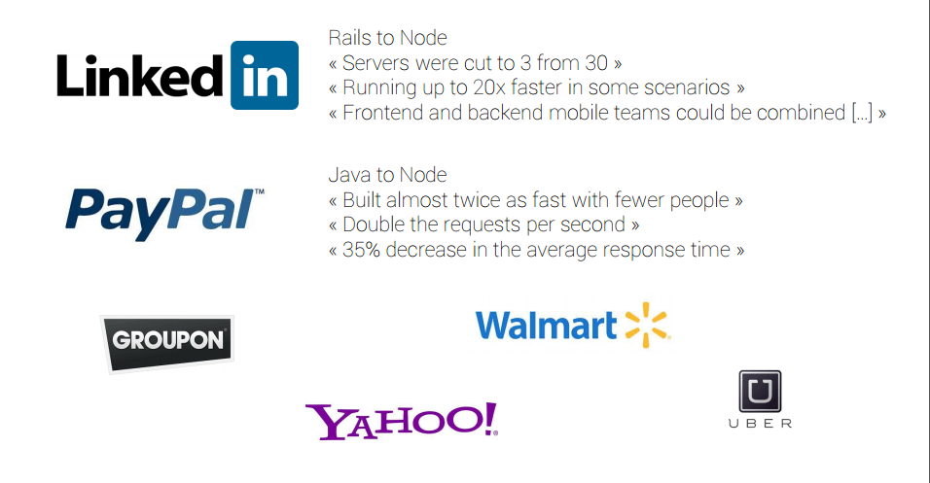
Success Stories…..

Slide 9
Advantages of node js
Less Learning Curve
Fast Development
Scalability
High Performance
Real-Time Applications
Great for Microservices
Easy Maintainability
Extensive Libraries
Vast Community
Cross-Platform
Highly Extensible

Slide 10
Node Js : Modules
What is module in node js?
Module in Node.js is a simple or complex functionality organized in single or multiple JavaScript files which can be reused throughout the Node.js application.
Node.js Module Types
Node.js includes three types of modules:
Core Modules/Built-in Modules
Local Modules
Third Party Modules/External Modules

Slide 11
Node.js Core Modules
Http Module:
It allows node.js applications to transfer data using HyperText Transfer Protocol (HTTP).
This module creates an HTTP server that listens to server ports and also gives responses back to the client.
Syntax : const http = require("http")
Distributed with node js itself
Core components of node js
Maintained by core contributors to the language
Only changes with new release of node js

Slide 12
The url module
We can use the url module for parsing.
This is a built-in module of node.js. It breaks down the url into readable parts. It is included in the file by using the require function;
To Parse an address, use the url.parse() method. It will return a URL object with each part of the address as its properties.
It is one of the core Node.js module.
So, we don't have to install it using NPM.
We write the following to require the url module.
Syntax :
const url = require('url');

Slide 13
The following table lists some of the important core modules in Node.js.
Core Module | Description
http | http module includes classes, methods and events to create Node.js http server.
url | url module includes methods for URL resolution and parsing.
querystring | querystring module includes methods to deal with query string.
path | path module includes methods to deal with file paths.
fs | fs module includes classes, methods, and events to work with file I/O.
util | util module includes utility functions useful for programmers.

Slide 14
Node.js Local Modules
Local modules are the modules that you define.
It makes your code easily reusable
To use local modules in your application, you need to load it using require() function in the same way as core module.
However, you need to specify the path of JavaScript file of the module.
Syntax:
var mynewModule = require('./Log.js');
mynewModule.info('Node.js started');

Slide 15
In the above example, app.js is using log module.
First, it loads the logging module using require() function and specified path where logging module is stored.
Logging module is contained in Log.js file in the root folder.
So, we have specified the path './Log.js' in the require() function. The '.' denotes a root folder.

Slide 16
Node.js External Modules
External modules are also known as third party modules and require a package manager that maintains all the modules so that they can be accessed with ease.
By default, node.js uses NPM [node package manager) package manager for JavaScript runtime environment.
The third-party module can be downloaded by NPM (Node Package Manager).
Some of the most popular third-party modules are:
Express
Socket.io
Mongoose
Third party modules can be install inside the project folder or globally.

Slide 17
Below are some differences between Node.JS and JavaScript:
Features | JavaScript | Node JS
Definition | It is an open-source, cross-platform, interpreted, lightweight scripting programming language that is used to develop dynamic and web applications. | It is a cross-platform, open-source JavaScript runtime environment that allows JavaScript to be run on the server.
Type | It is a programming language. It works in any browser that has a proper browser engine. | It's a JavaScript interpreter and environment with some valuable libraries that JavaScript programming can use separately.
Dedicated Server | It is generally used on the client-side server. | It is generally used on the server-side.

Slide 18
Community | All the JavaScript is not important to the node community. | All node projects represent the JavaScript community.
Running Engines | JavaScript can be run on any engine, including Spider Monkey, V8, and JavaScript Core. | Node JS is only supported by the V8 engine, which Google Chrome mostly uses. Any JavaScript program written with Node JS will always be run in the V8 engine.
Used for | It is designed to build network-centric applications. | It's designed for data-intensive real-time applications that run on several platforms.
Languages | It's a newer version of the ECMA script that runs on Chrome's V8 engine, which is written in C++. | It uses C, C++, and JavaScript.
Modules | Few JavaScript frameworks are TypedJS, RamdaJS, etc. | Lodash, express are examples of Nodejs modules. These all modules are to be imported from npm.
Companies Uses | Various companies use JavaScript like Google, Shopify, Udacity, Sendgrid, Groupon, Okta, Instacart, etc. | Various companies use Node Js like Netflix, Hapi, Walmart, Paypal, Linkedin, Trello, Medium, eBay, etc.

Slide 19


